Slide 1
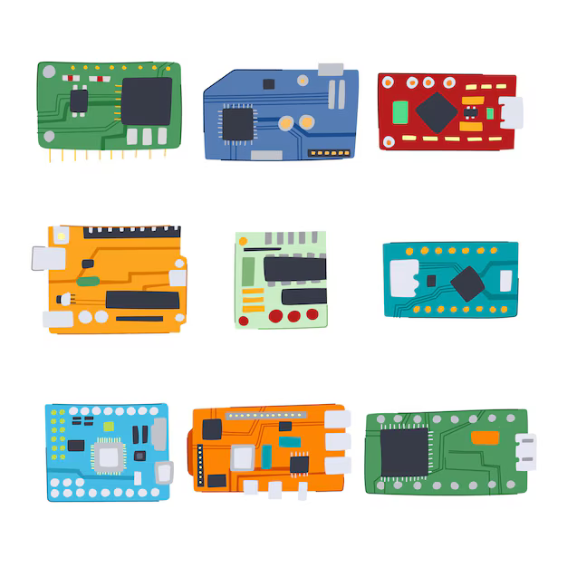
Interactive Art with Arduino: From Zero to One
Borui Wang
Image courtesy: pikepicture

Slide 2
What do you want to build?
A canvas that glows warmer when you whisper secrets to it...
A sculpture that 'shivers' or vibrates when the room gets too cold...

Slide 3

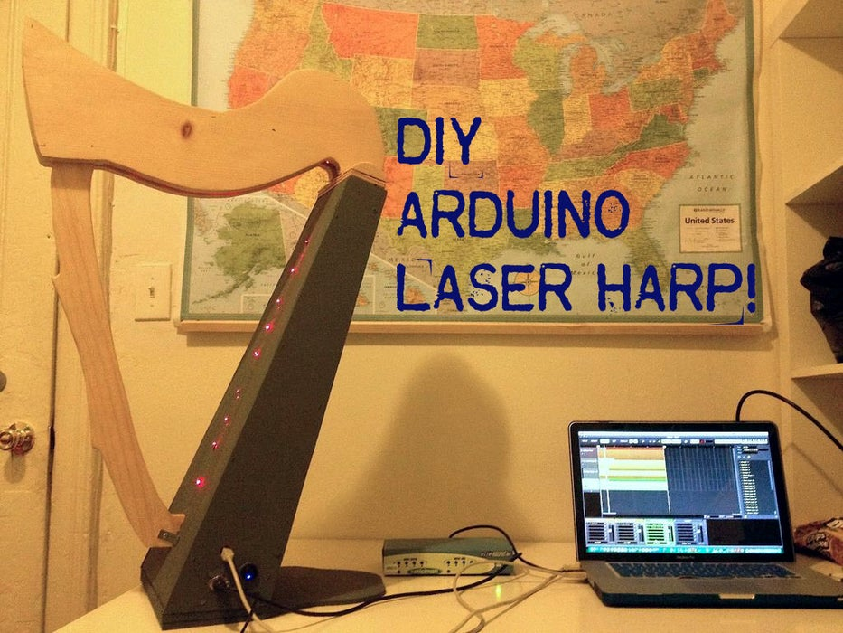
Inspiration: Let’s see what others made!
Image courtesy: Instructables

Slide 4
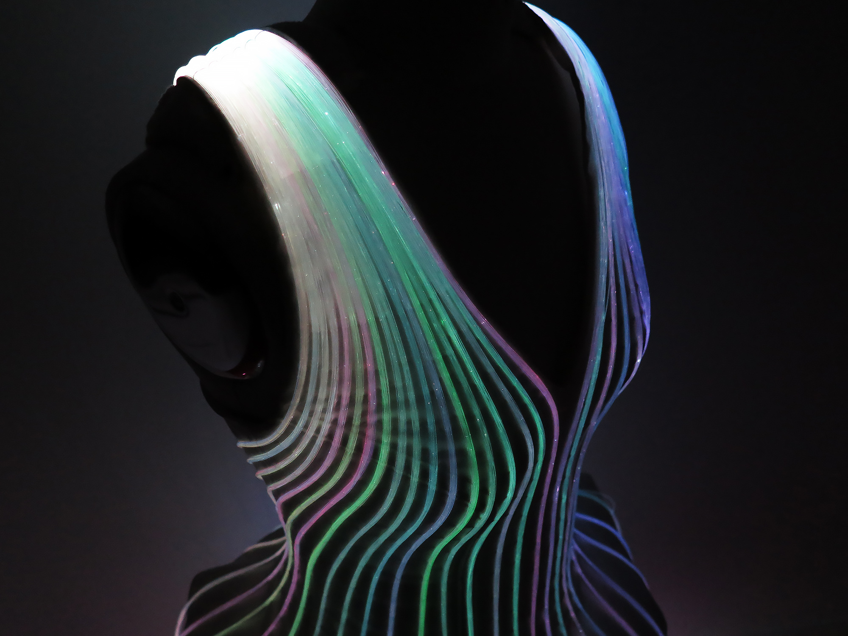
Fiber Optic Dress
Image courtesy: Natalina from Instructables

Slide 5
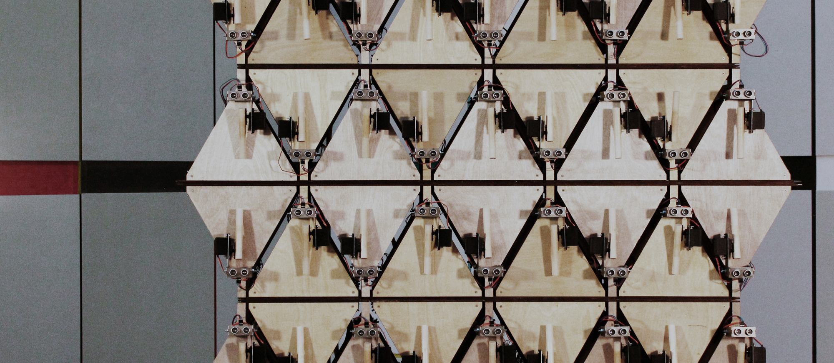
Modular Rhythm Machine
Image courtesy: Nicolás Kisic Aguirre

Slide 6
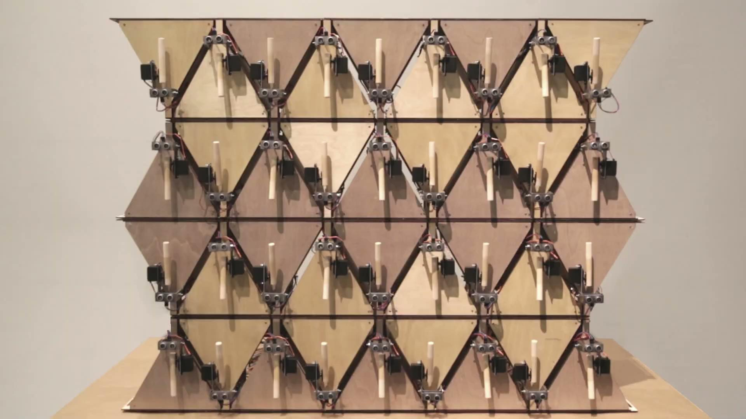
Modular Rhythm Machine

Slide 7
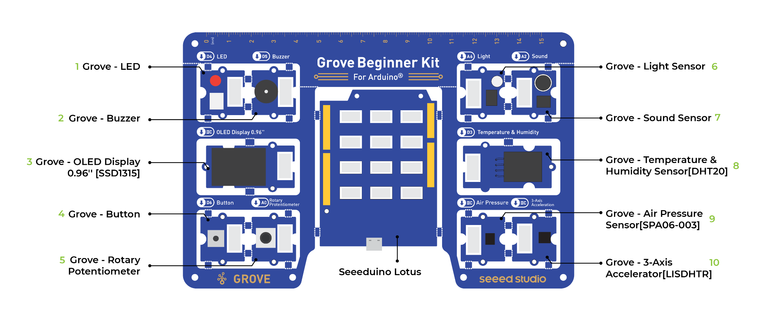
Your Tool: Grove Beginner Kit
Arduino + 10 pre-connected modules
The center piece is the Arduino
Image courtesy: Seeed Studio

Slide 8
Left Side Modules—
Direct Interaction
1 LED
2 Buzzer: Make beeping sound
3 A (very small) screen
4 Button!
5 Potentiometer: Rotate ~ 360 deg, detects the angle of your rotation
Image courtesy: Seeed Studio

Slide 9
Right Side Modules—
Environmental Sensors
6 Detect light intensity
7 Detect sound intensity
8 Detect temperature and humidity
9 Detect atmospheric pressure
10 Detects object’s acceleration
Image courtesy: Seeed Studio

Slide 10
Right Side—
Environmental Sensors
6 Detect light intensity
7 Detect sound intensity
8 Detect temperature and humidity
9 Detect atmospheric pressure
10 Detects object’s acceleration
Image courtesy: Seeed Studio

Slide 11
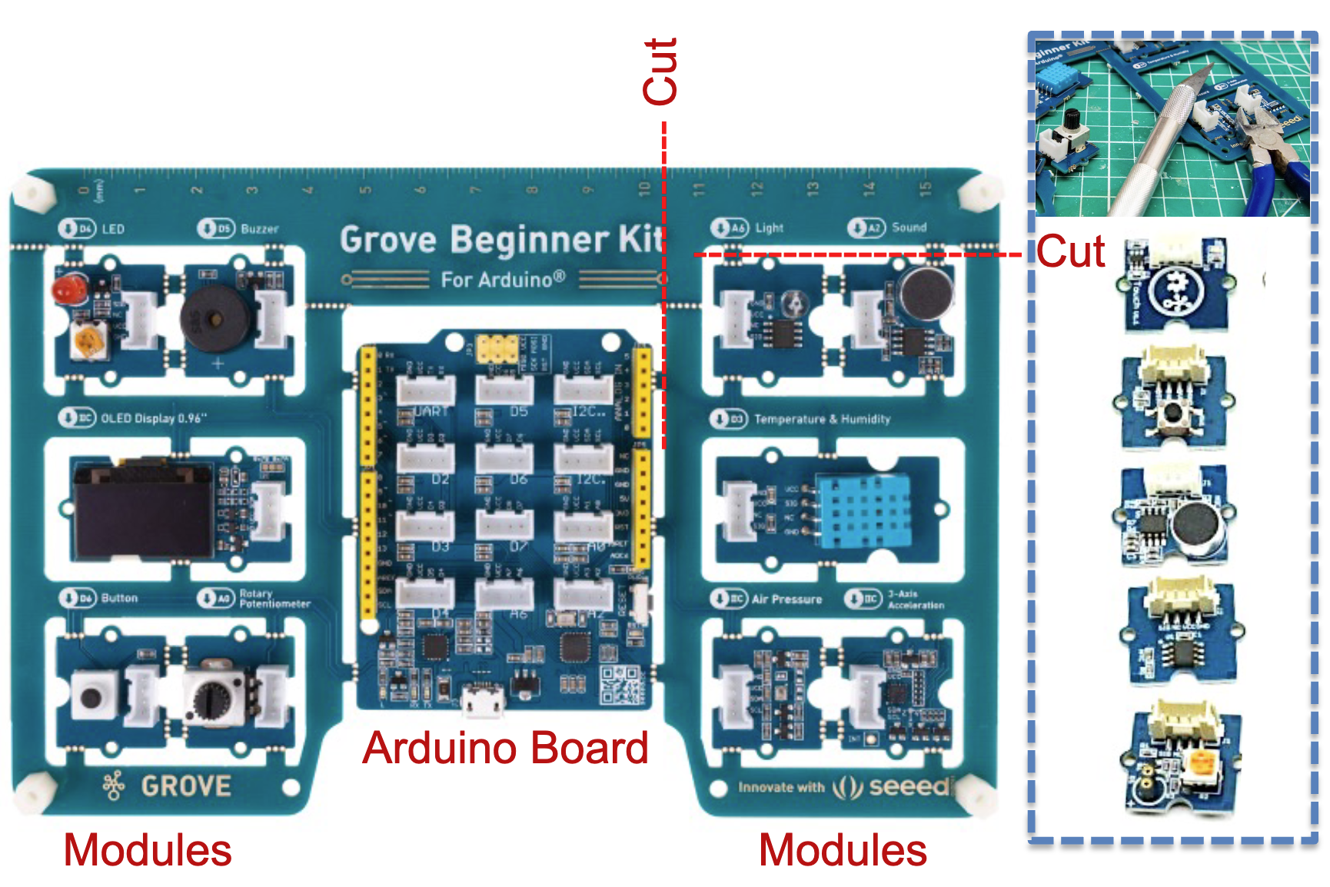
Image courtesy: Professor Keith Evan Green
cut
Later, you can cut these out and connect with the provided cable… But not now!

Slide 12
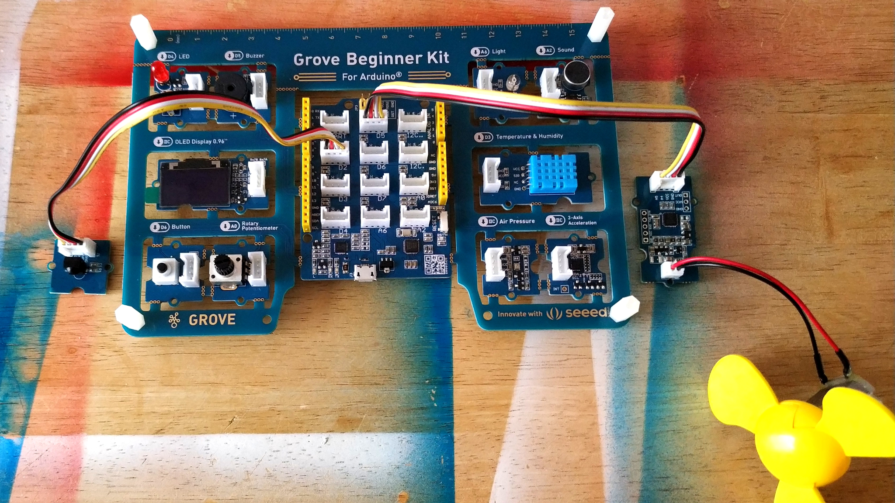
Image courtesy: Tom’s Hardware
Also you can add more modules you need / like!

Slide 13
Power On & Demo
No Coding Needed (Yet!)
Plug in: Connect the USB cable to your laptop or power bank.
Explore: Twist the dial to scroll through module demos.
Select: Press the button to try one.
Exit: Long-press the button to go back to the menu.
Image courtesy: Seeed Studio

Slide 14
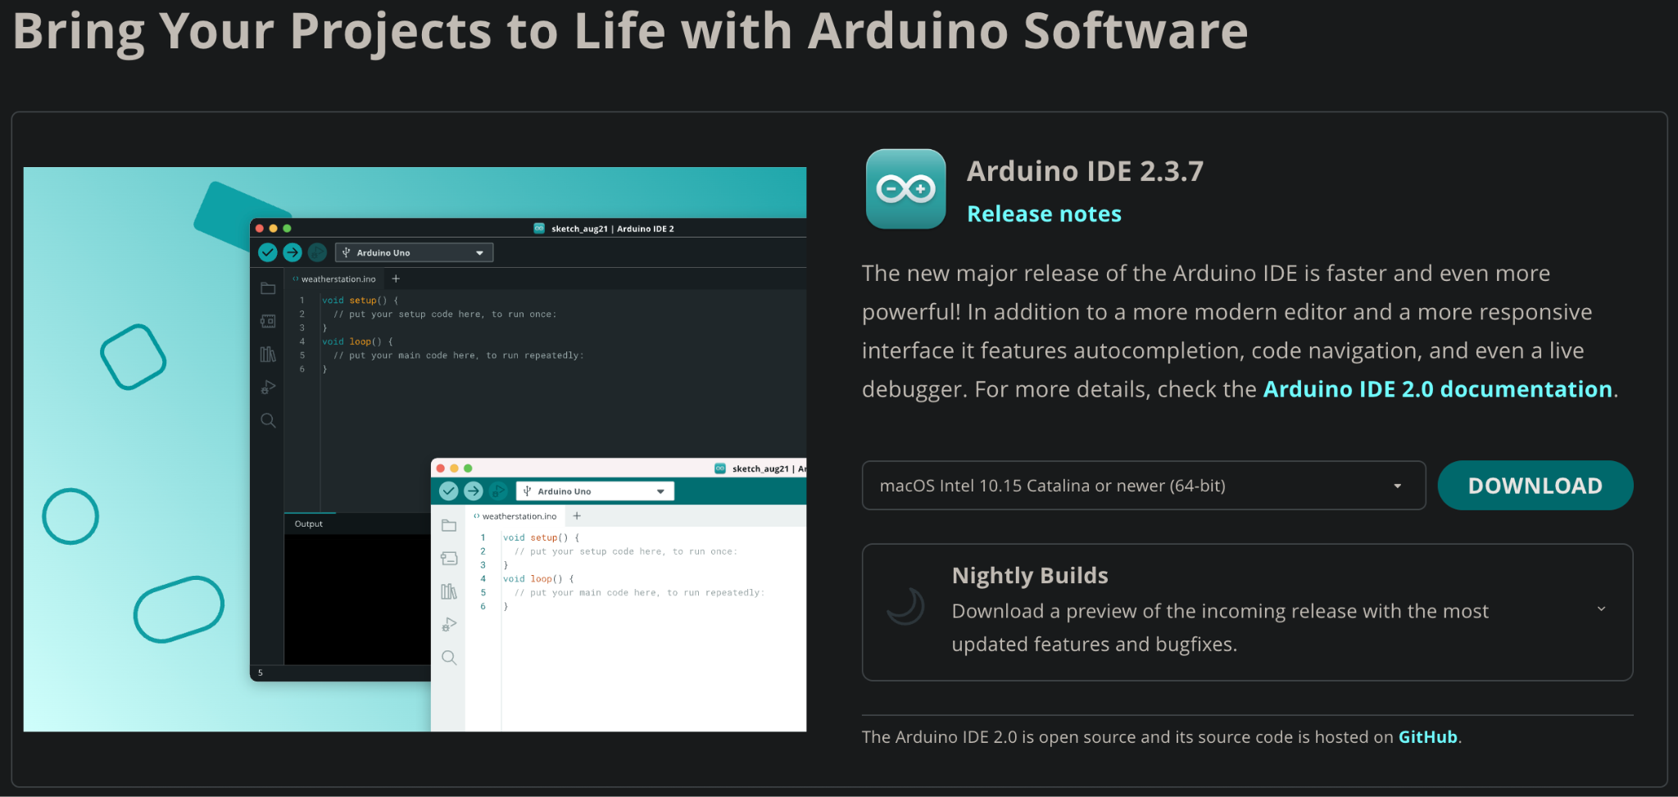

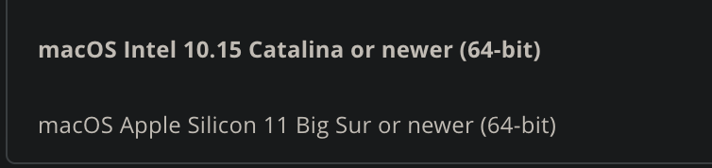
Creating Your Code—Set up IDE
https://www.arduino.cc/en/software/
Mac Users: choose Apple Silicone if you have M series chip

Slide 15

Download USB Driver

Slide 16
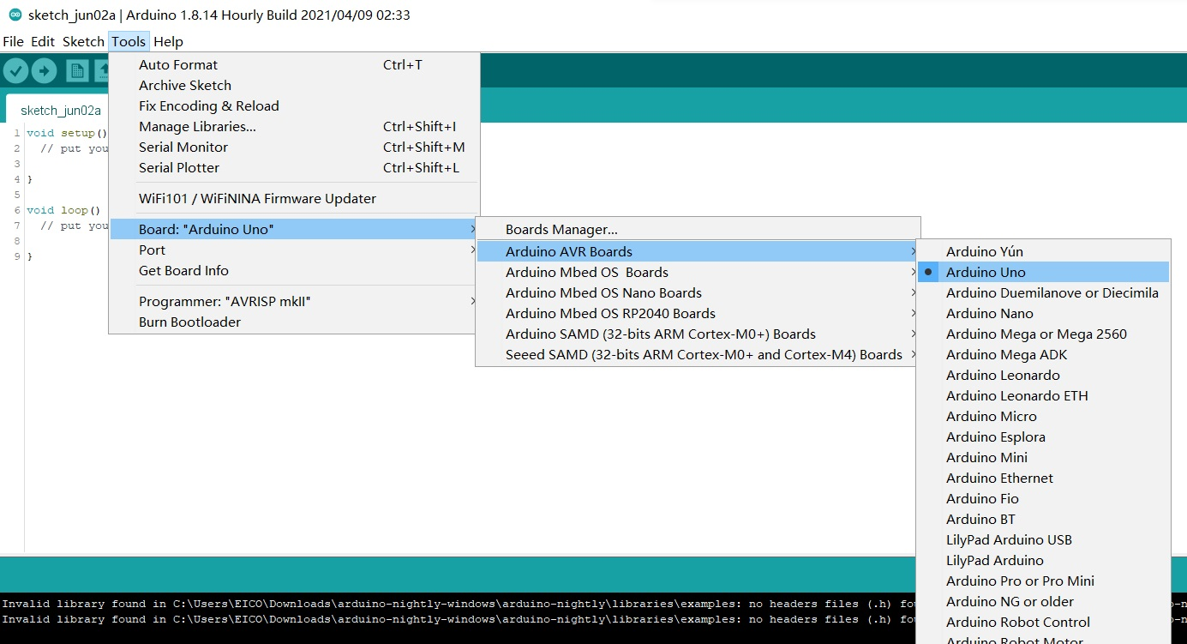
Select the Port
Image courtesy: Seeed Studio

Slide 17
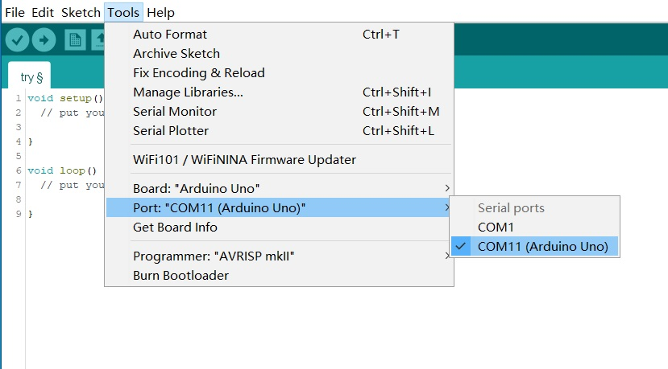
Select the Board
Board: Tools → Board → Arduino Uno
Port: Tools → Port → COMX (Arduino Uno) (Windows) or xx.usbserial-xxxx (Mac)
Image courtesy: Seeed Studio

Slide 18
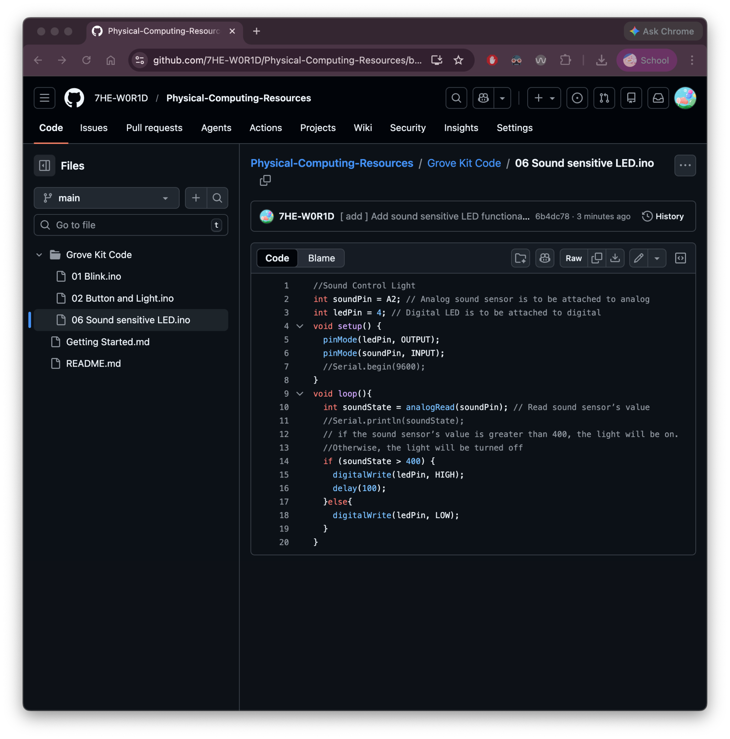
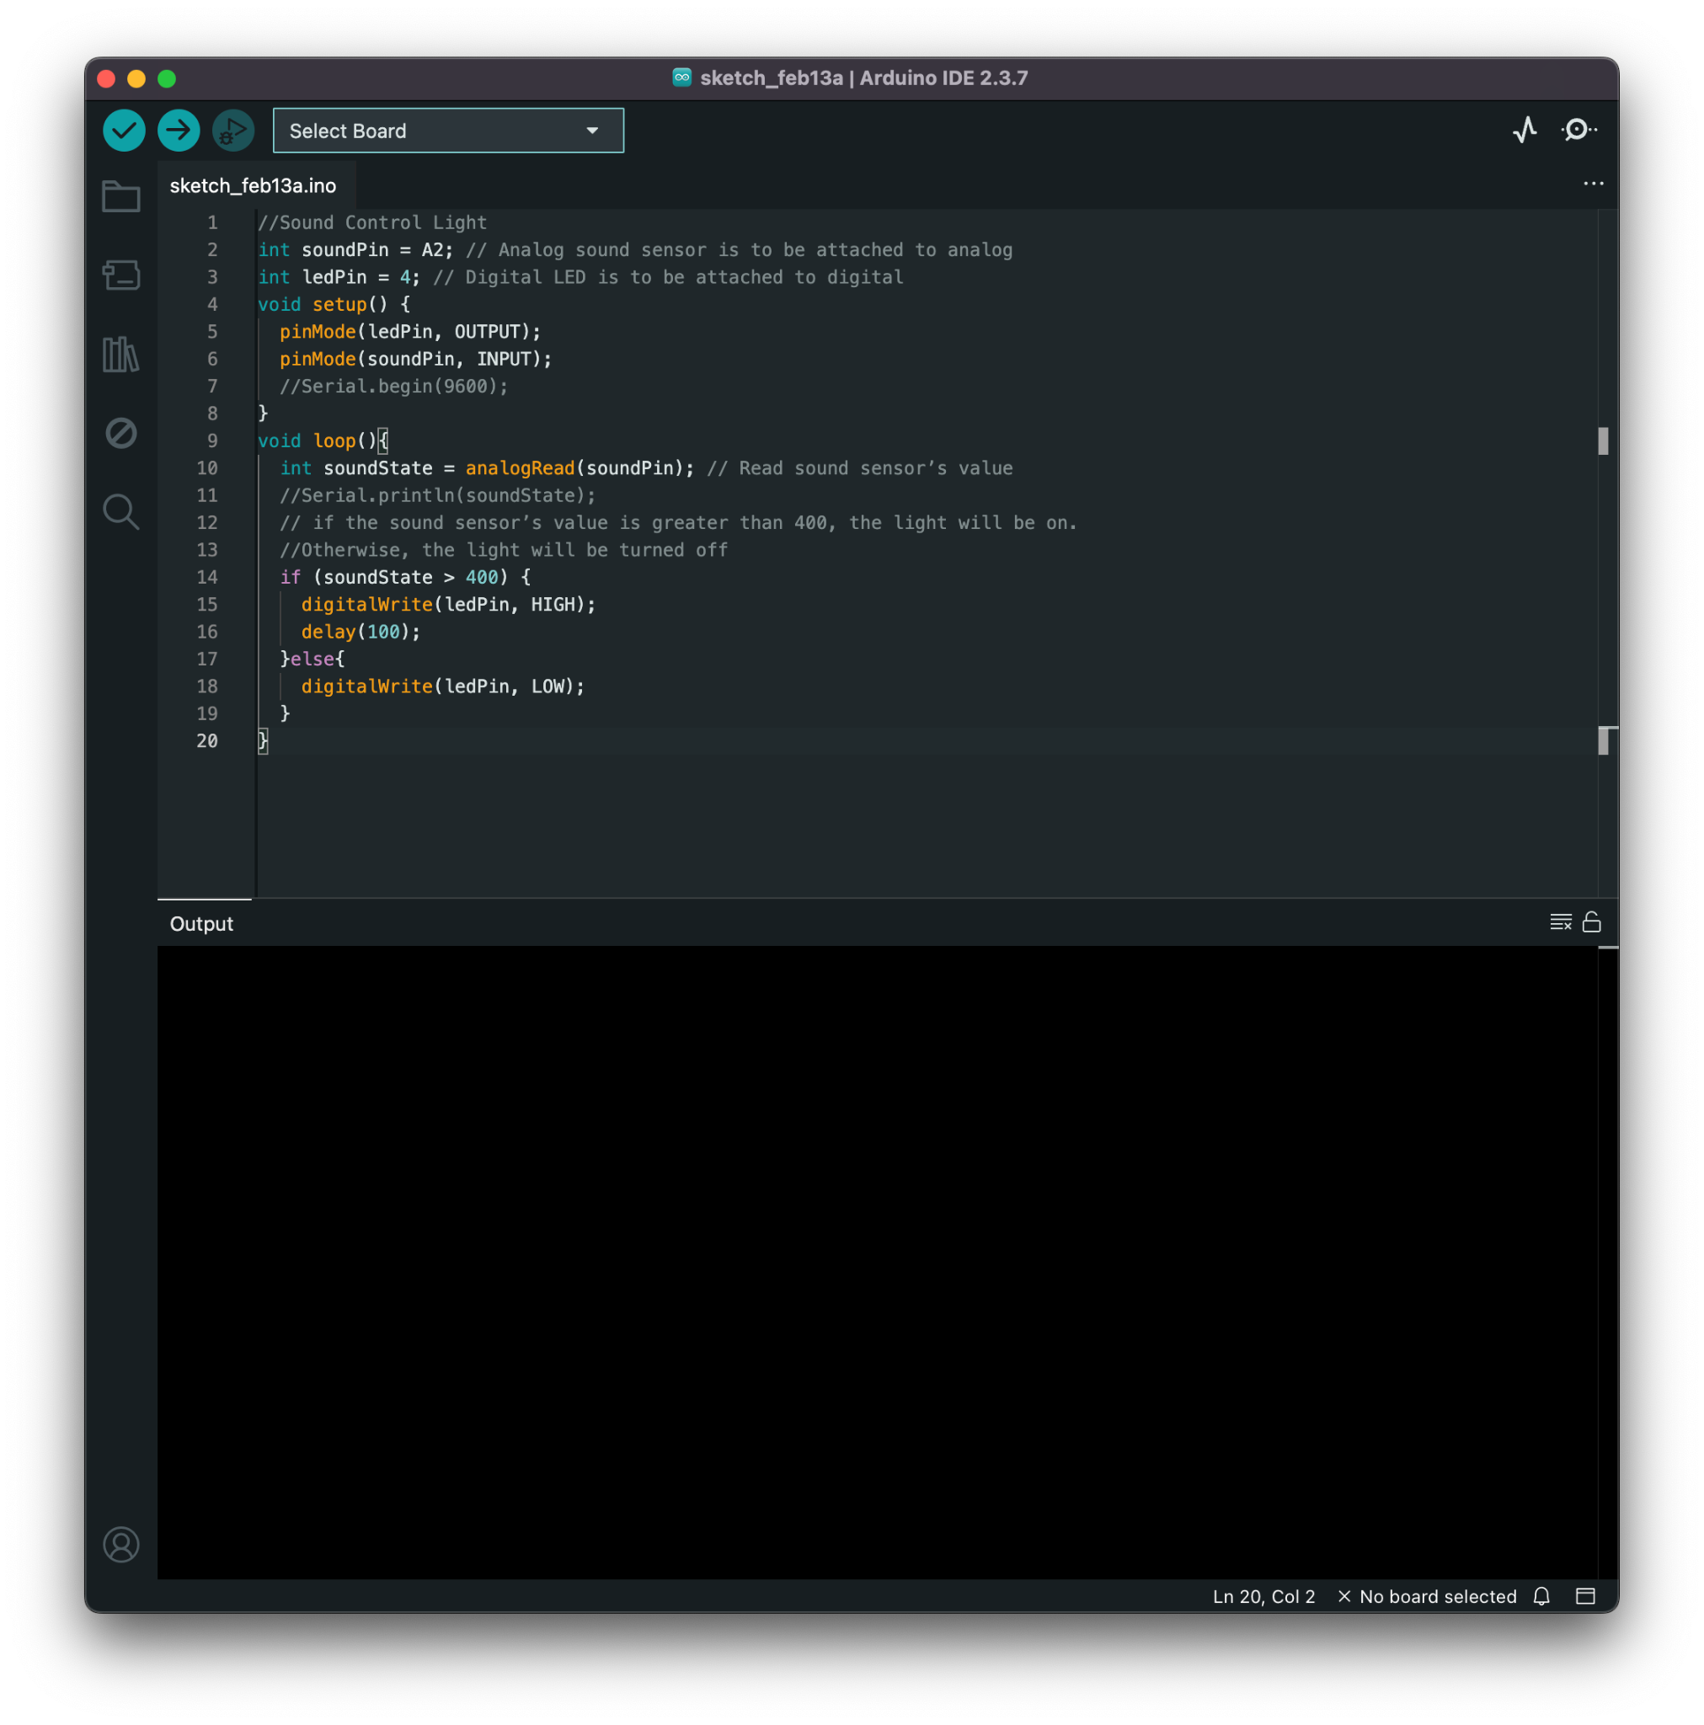
Make the LED blink
https://tinyurl.com/INFO4940-soundblink

Slide 19
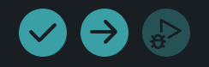
Make the LED blink
https://tinyurl.com/INFO4940-soundblink
Click on to verify code (app checks for obvious errors)
Then, if no errors, click on
to upload code to Arduino

Slide 20
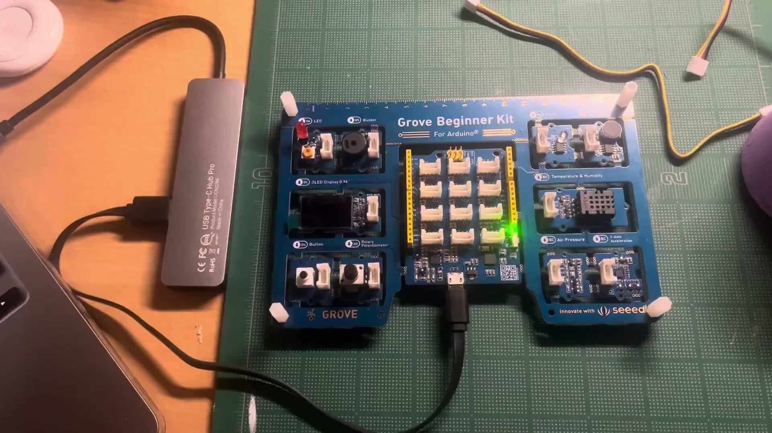

Slide 21
What if I have errors?
I see "No board selected" or "Missing FOBN".
Fix: Go back to Tools > Board and Tools > Port to make sure "Arduino Uno" is checked.
No error shown, but my LED is not lighting up
Fix: double-check your pin numbers in the code, is it 4 for LED (not 13)?
The computer doesn't show any "COM" or "usbserial" ports.
Fix: Install the CP210x Driver.

Slide 22
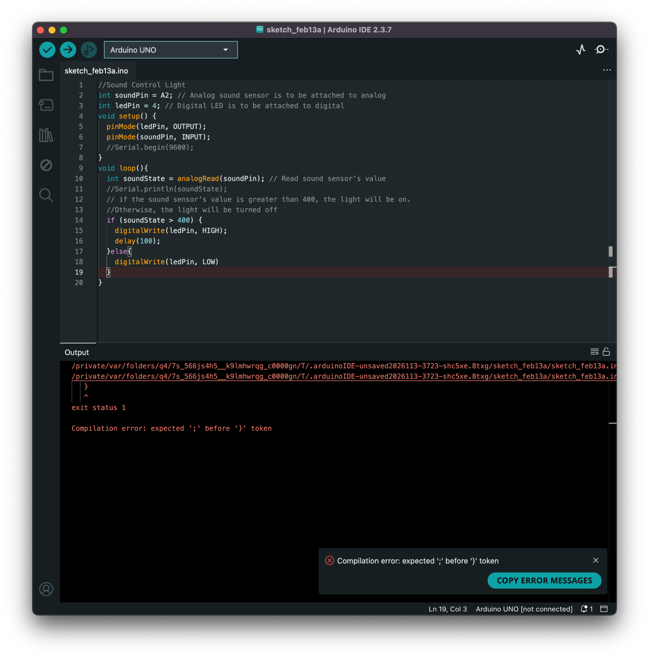
…it's not any of those!
Use AI to help you!
Copy error messages
Copy all of your code

Slide 23
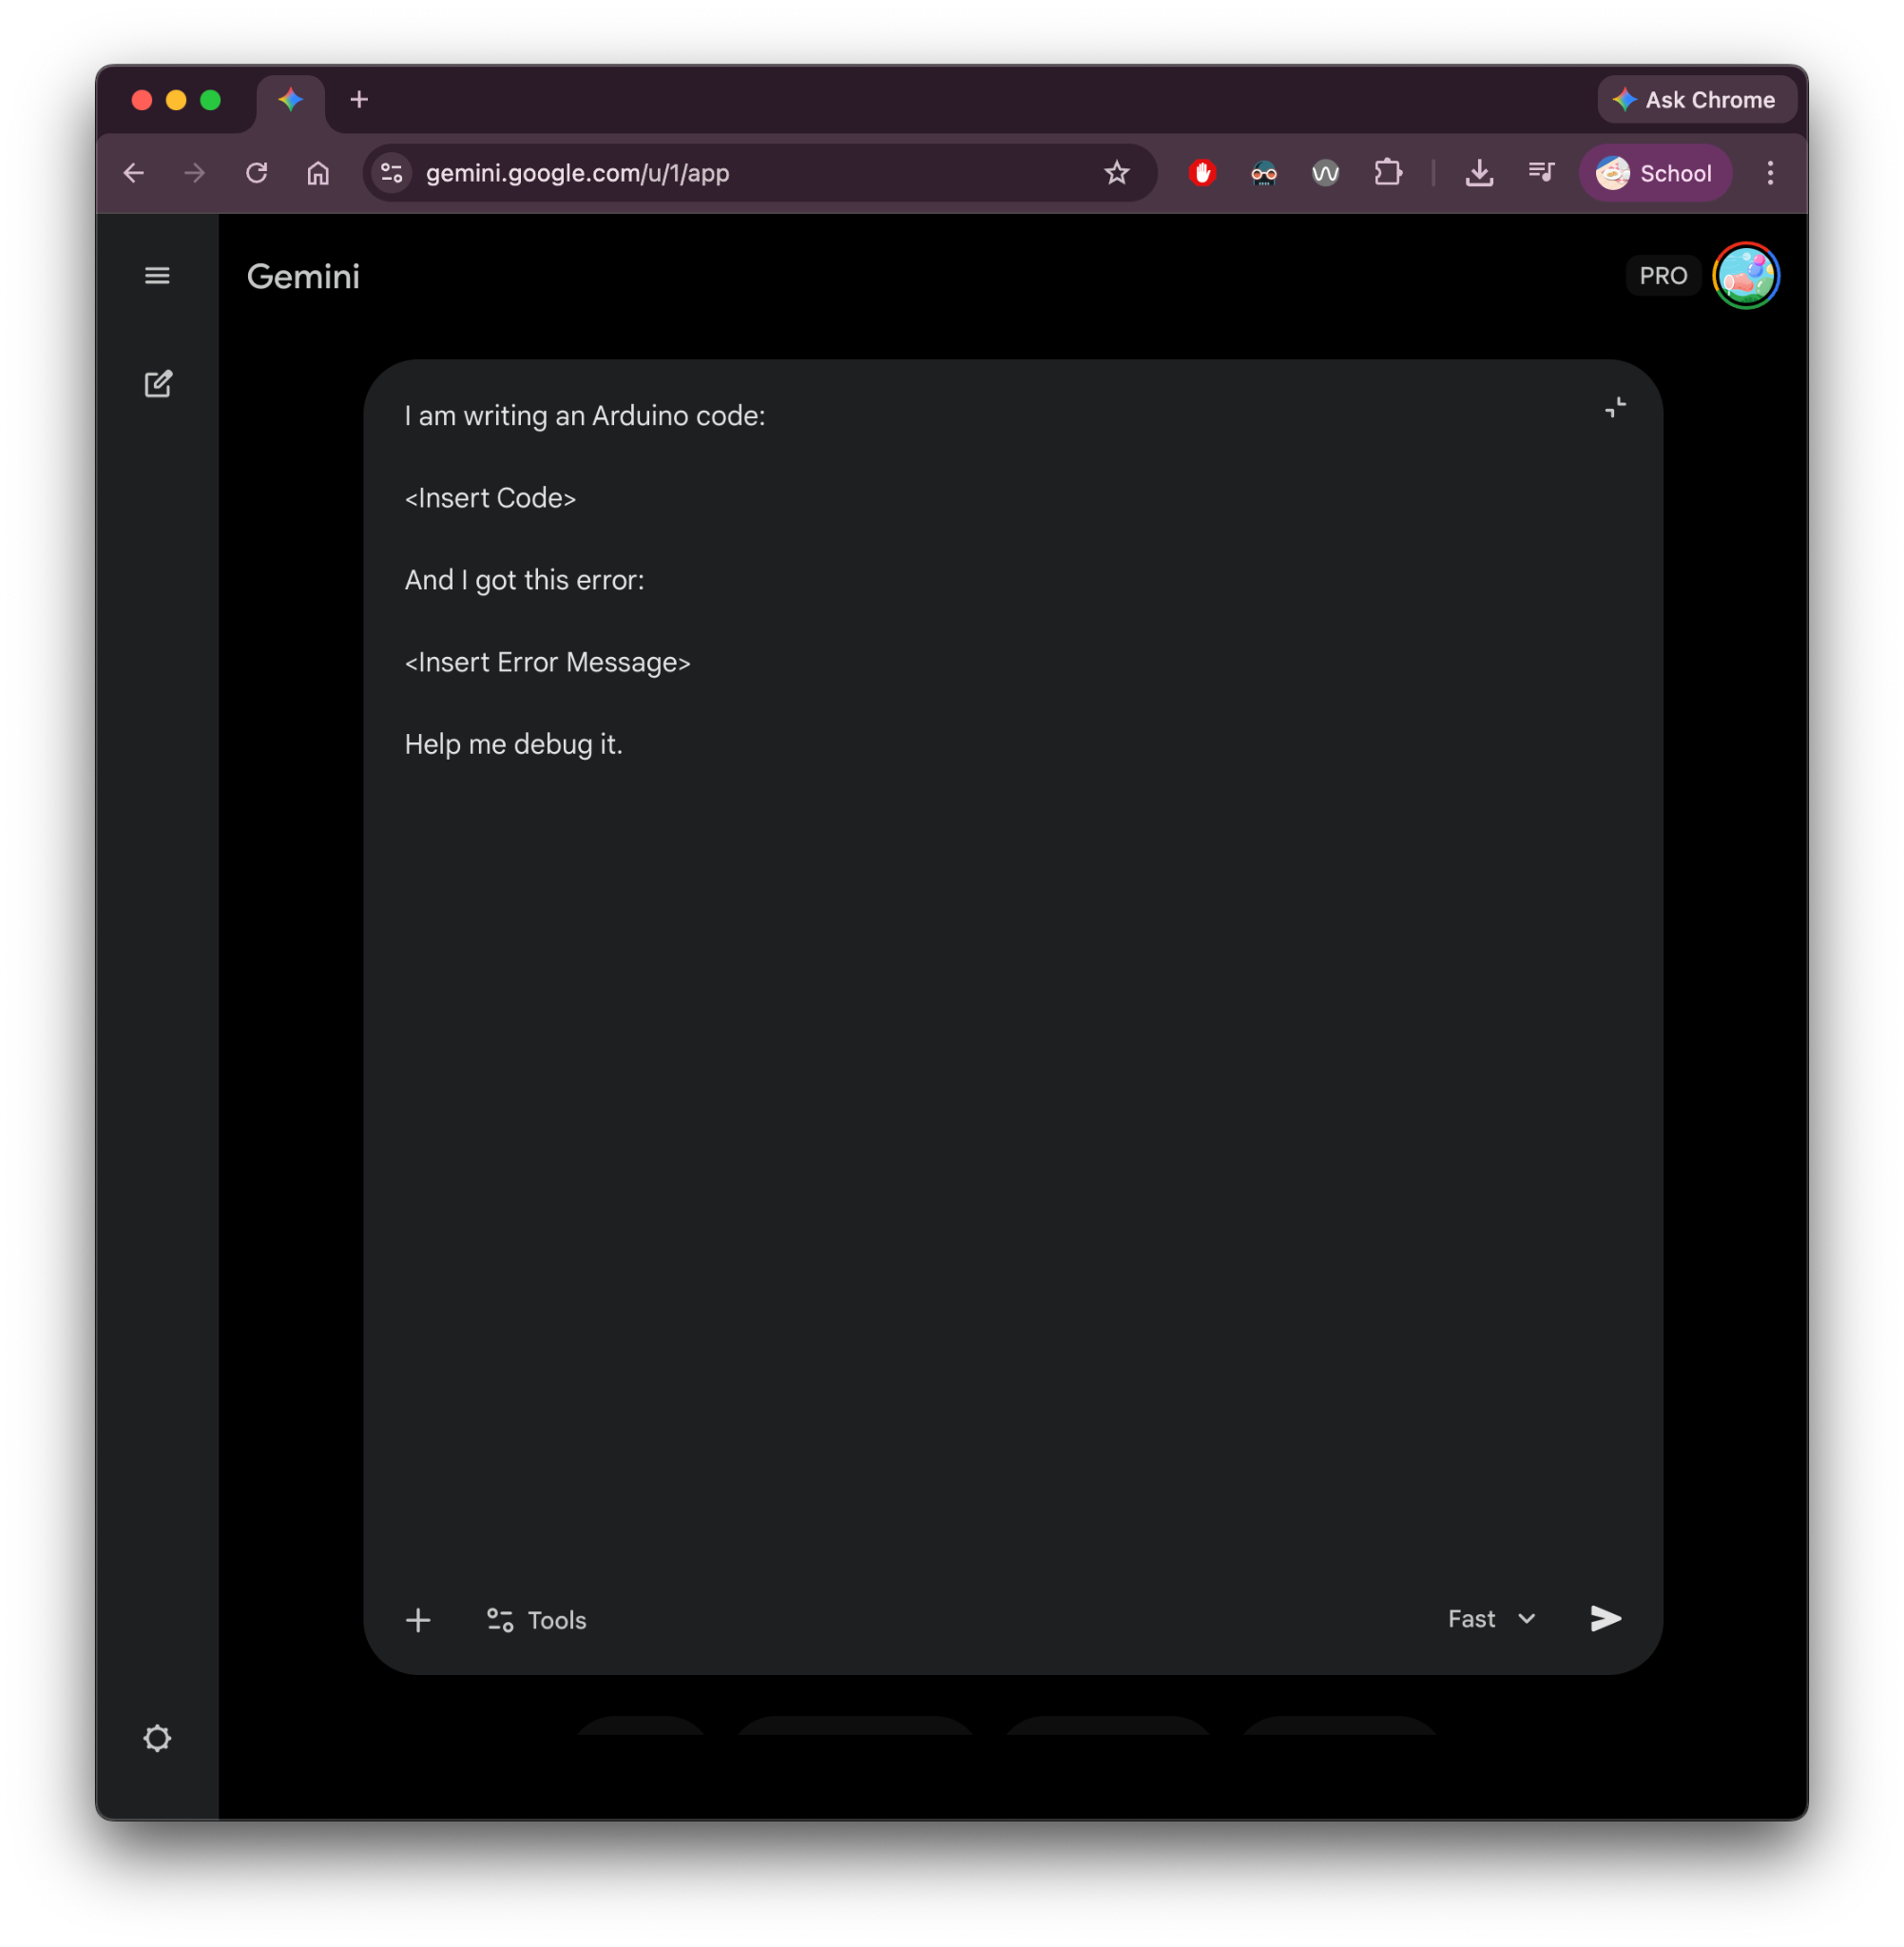
…it's not any of those!
Paste it using the following syntax (or edit to fit your style)
I am writing an Arduino code:
<Insert Code>
And I got this error:
<Insert Error Message>
Help me debug it.

Slide 24
I want the light to be more/less sensitive…

Slide 25
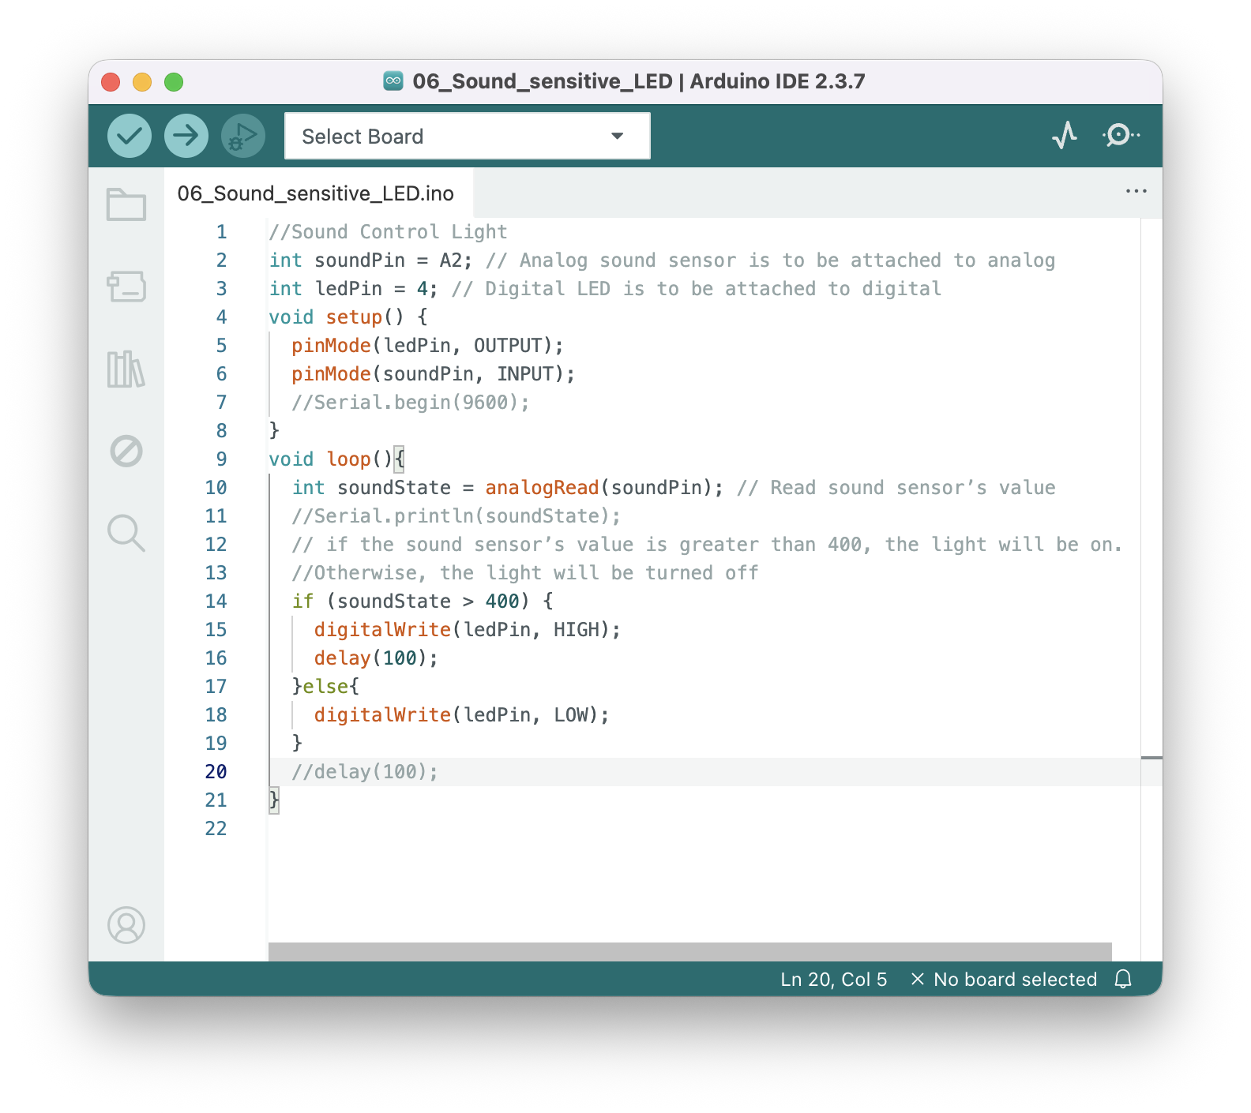
I want the light to be more/less sensitive
But how much more / less sensitive?
Arduino can give you the answer!
Delete the // at the beginning of these lines
//Serial.begin(9600);
//Serial.println(soundState);
//delay(100);
Now they should be colored
Verify code and upload

Slide 26
I want the light to be more/less sensitive
But how much more / less sensitive?
Arduino can give you the answer!
Delete the // at the beginning of these lines
//Serial.begin(9600);
//Serial.println(soundState);
//delay(100);
Now they should be colored
Verify code and upload
So data won’t scroll too fast!

Slide 27

I want the light to be more/less sensitive
Open Serial Monitor at the top right corner
Serial monitor is the way you “listen” and “talk” to the Arduino.

Slide 28
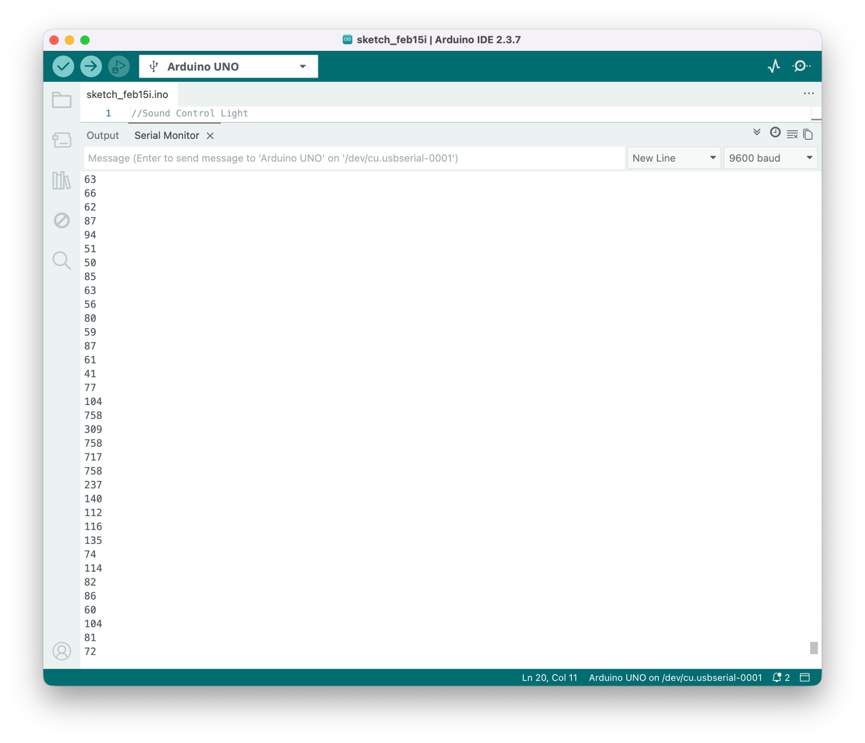
I want the light to be more/less sensitive
Do your desired action and see the change in numbers!

Slide 29
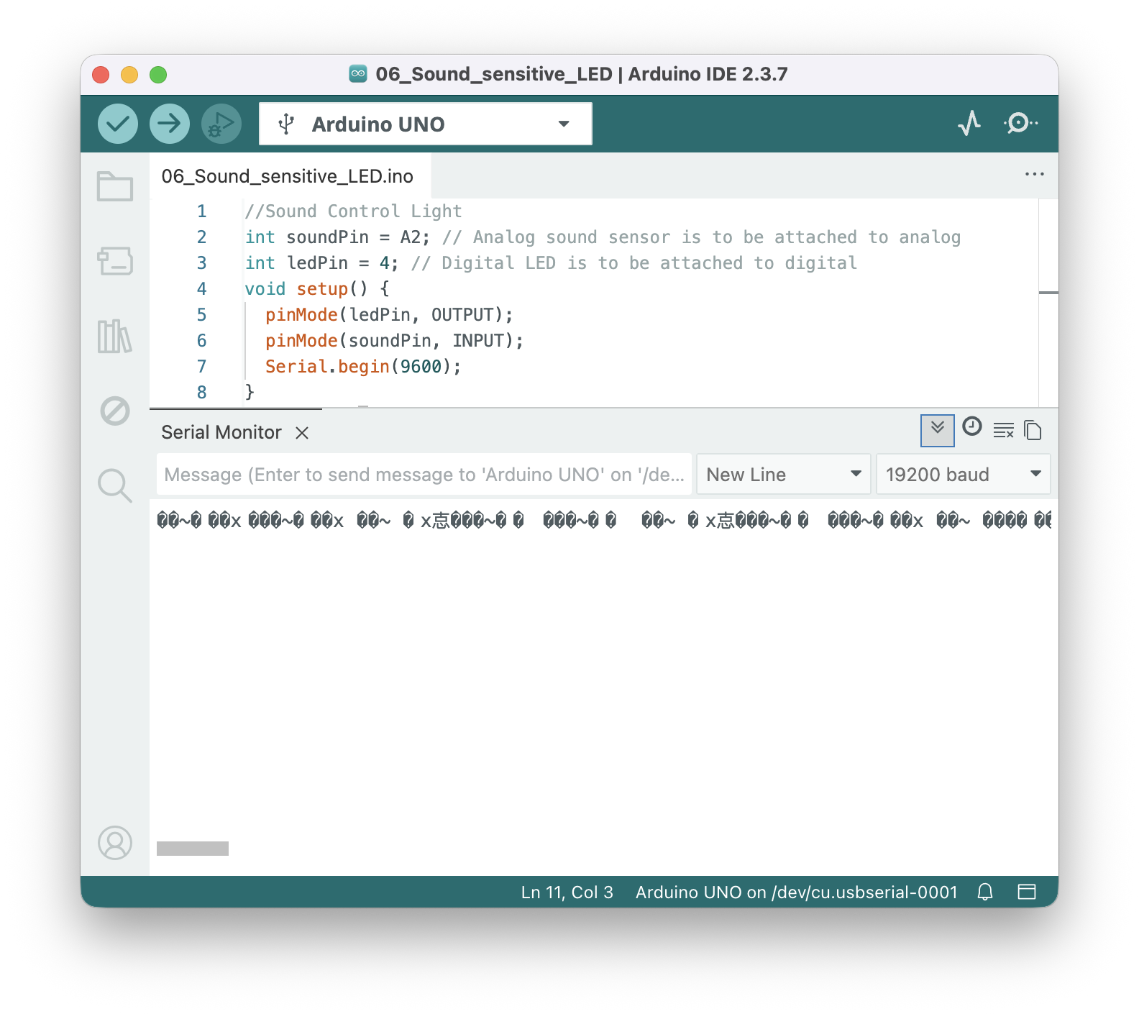
Empty or garbled text?
Check if your Serial.begin(XXXX) matches your serial monitor baud!
Wrong!

Slide 30
I want the light to be more/less sensitive
Click
Value > 700 = Click

Slide 31

I want the light to be more/less sensitive
Change 400 in soundState > 400 to your determined new number
700 now!

Slide 32
I want the light to be more/less sensitive
Change 400 in soundState > 400 to your determined new number
Add back the // at the beginning of these lines
//Serial.begin(9600);
//Serial.println(soundState);
//delay(100);
Verify code and upload
700 now!

Slide 33
Reflections
Recall your answers: "What do you want to build?"
Nobody said, "I'm here to learn circuit theory today."
Recall the "30s Romantic Love" Assignment
We didn't critique your editing software or camera settings.
Our discussion focused on the emotions and ideas you conveyed.
The Camera was just a Tool
The lens didn't make the art; your vision did.
Arduino is no different
It is simply a "lens" to help you express a thought.

Slide 34
Reflections
Recall your answers: "What do you want to build?"
Nobody said, "I'm here to learn circuit theory today."
Recall the "30s Romantic Love" Assignment
We didn't critique your editing software or camera settings.
Our discussion focused on the emotions and ideas you conveyed.
The Camera was just a Tool
The lens didn't make the art; your vision did.
Arduino is no different
It is simply a "lens" to help you express a thought.

Slide 35
Reflections
Recall your answers: "What do you want to build?"
Nobody said, "I'm here to learn circuit theory today."
Recall the "30s Romantic Love" Assignment
We didn't critique your editing software or camera settings.
Our discussion focused on the emotions and ideas you conveyed.
The Camera was just a Tool
The lens didn't make the art; your vision did.
Arduino is no different
It is simply a "lens" to help you express a thought.

Slide 36
The Tool Mindset in Action
Don't Reinvent the Wheel
If you want to build something, there is likely already a Library or an AI prompt for that.
Just-in-Time Learning
Only learn the specific modules your project requires.
Be an "Architect," not a Scientist
Your role is to assemble these Grove modules like Lego bricks to tell a story.
"Good Enough" is Perfect
If the interaction works and the message is clear, the technology has done its job.

Slide 37
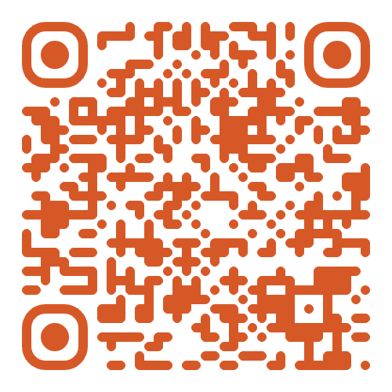

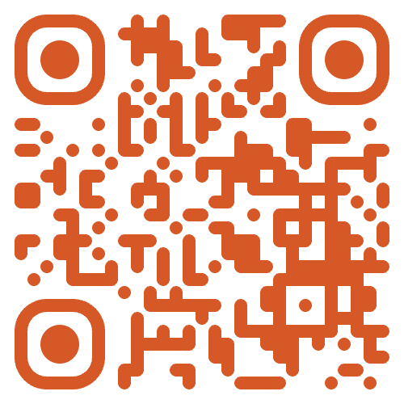
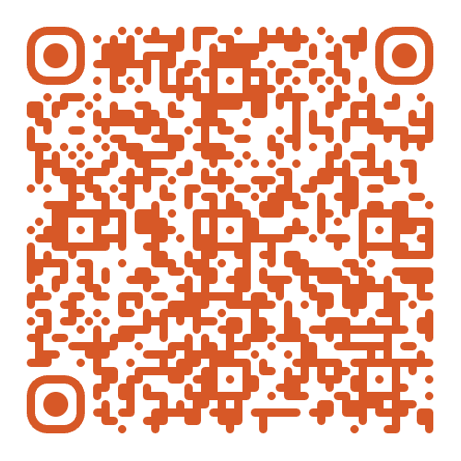
Useful Resources
ARL
My repository: This slide, code, and other useful information.
ARL Learning Slides: Detailed hardware walkthrough from my lab, built for a similar class.
Instructables.com: A massive DIY library with step-by-step guides.
Arduino Forum and Project Hub: The official hub. Use the "Project Guidance" section to discuss ideas or the "Troubleshooting" section for technical bugs.
And don’t forget your Professor and TA!
Notes:
If you prefer, you can also google these instead of scanning the slide QR

Slide 38
Questions?

Slide 39
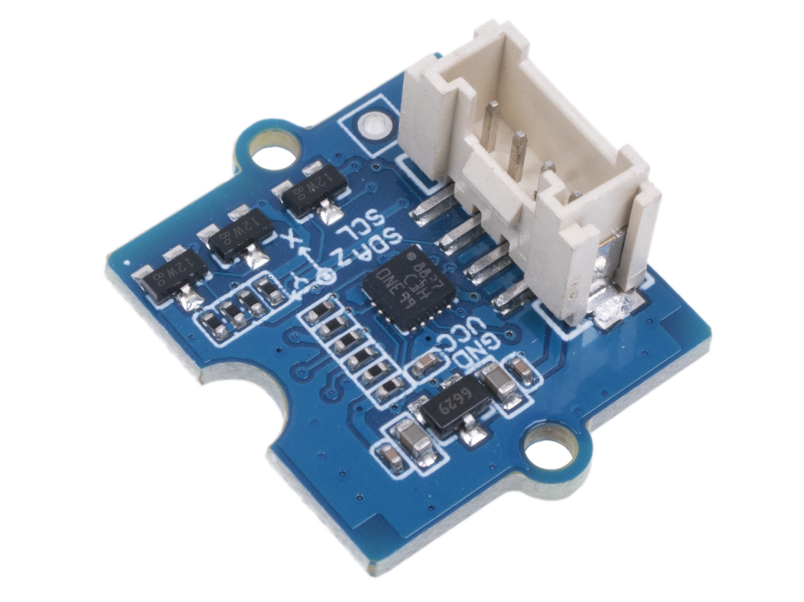
More Complex Sensors
LIS3DHTR 3 axis accelerometer
Senses movement and orientation
How does it communicate with Arduino?
Image courtesy: Seeed Studio

Slide 40
More Complex Sensors
LIS3DHTR 3 axis accelerometer
Senses movement and orientation
How does it communicate with Arduino?
You don’t need to know! You just need a library.
Image courtesy: Seeed Studio

Slide 41
More Complex Sensors
LIS3DHTR 3 axis accelerometer
Senses movement and orientation
How does it communicate with Arduino?
You don’t need to know! You just need a library.
Don't reinvent the wheel!
Image courtesy: Seeed Studio
Notes:
a collection of code that someone else already wrote and tested. You just "import" it and use simple commands.

Slide 42
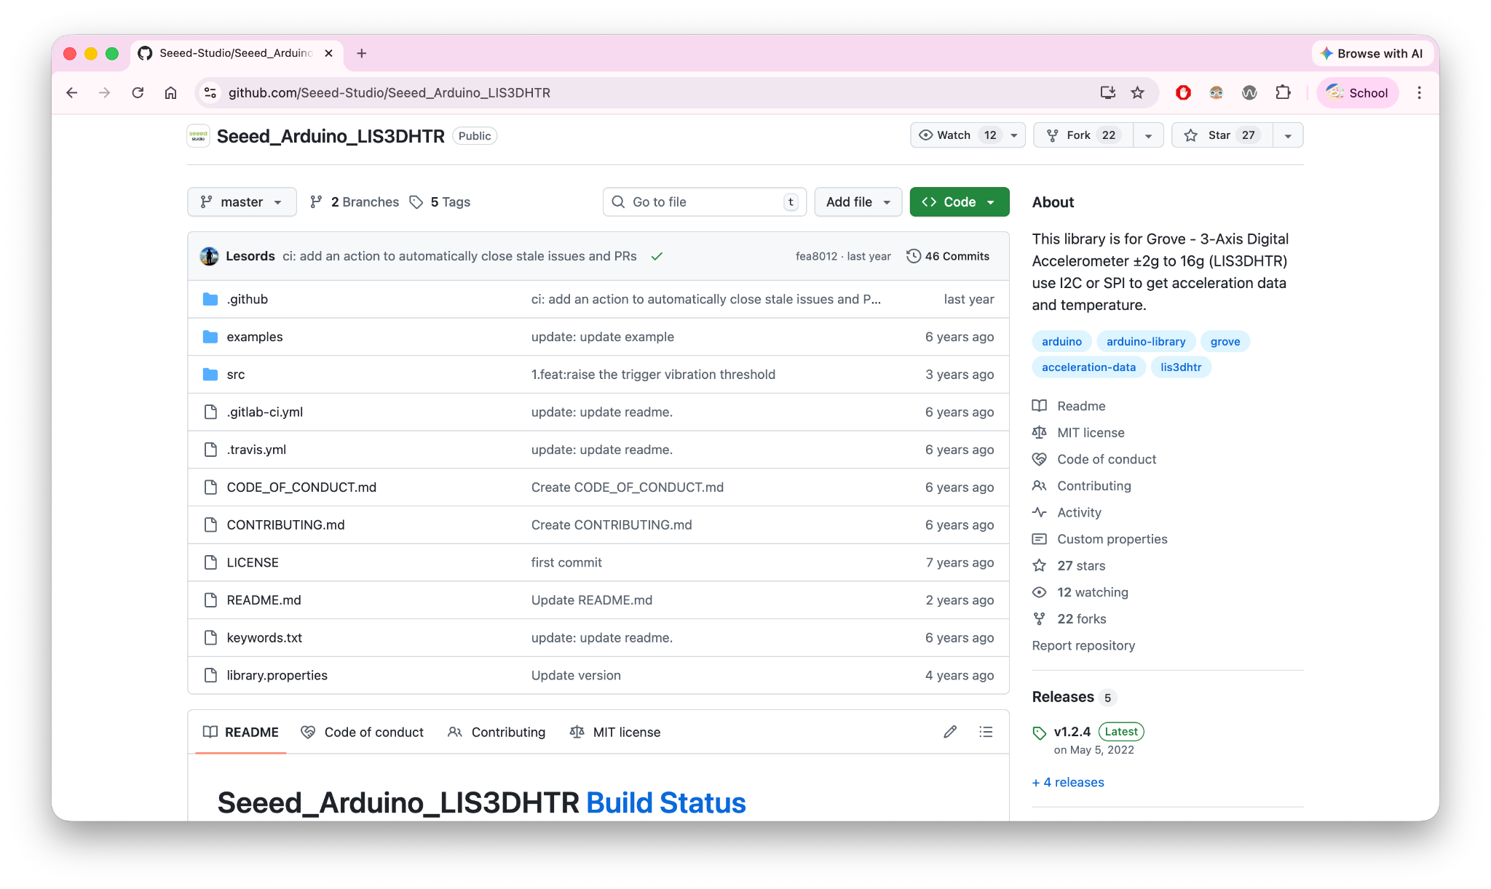
Visit https://tinyurl.com/INFO4940LIS

Slide 43
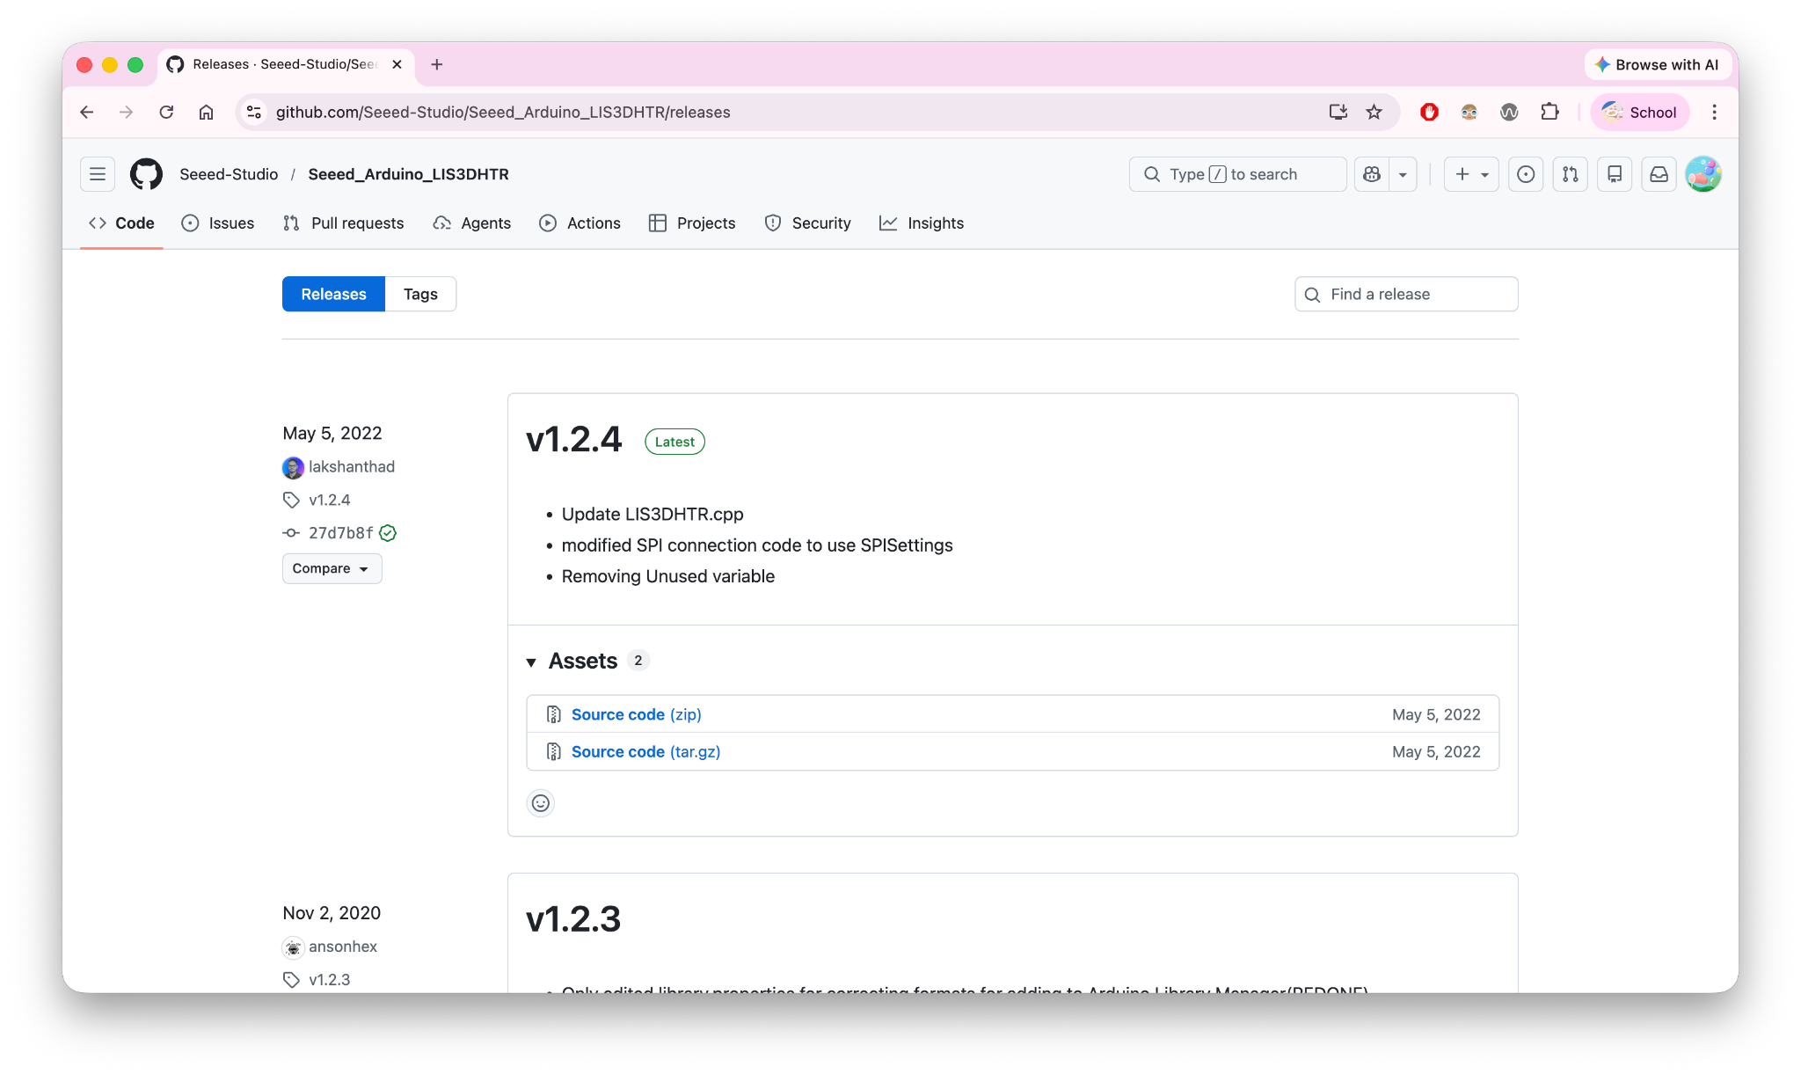

Slide 44
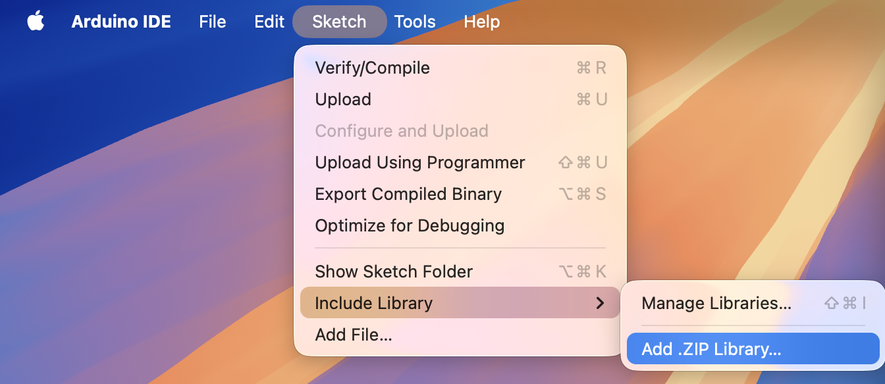
Add the .zip file you just downloaded

Slide 45
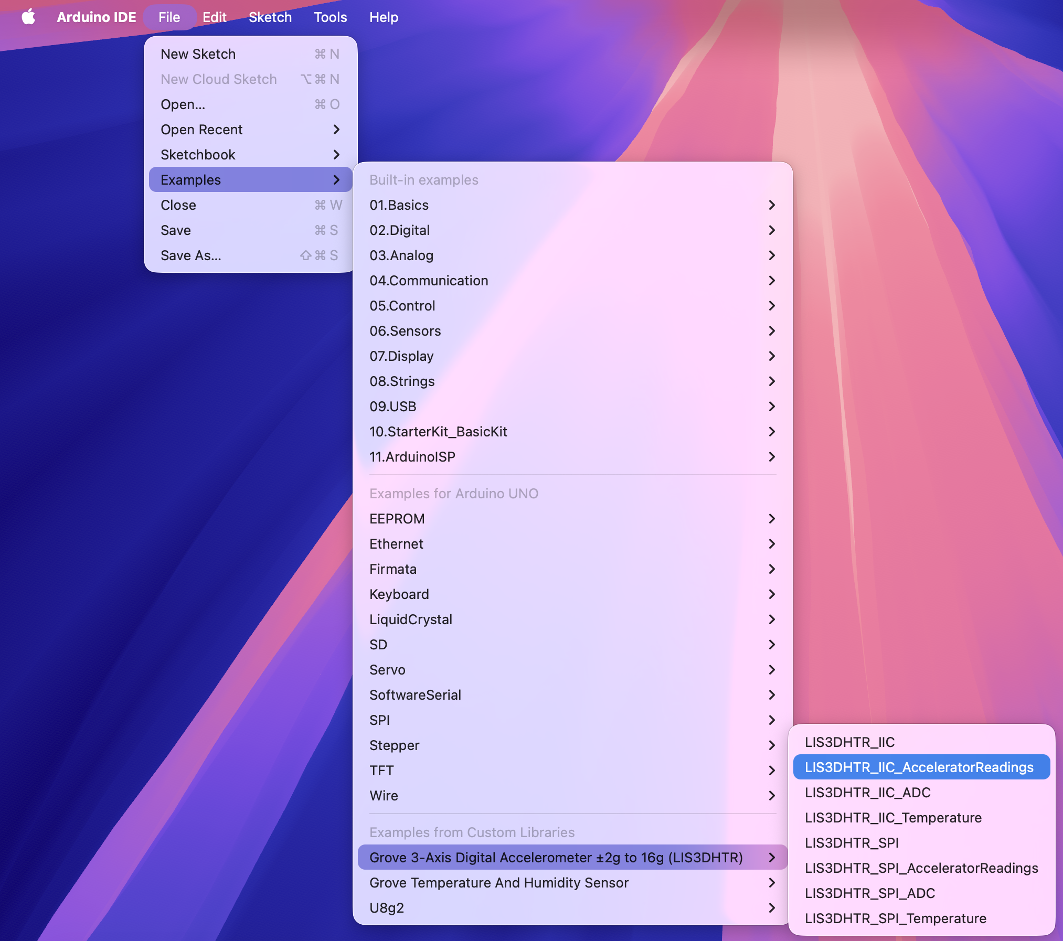

Slide 46
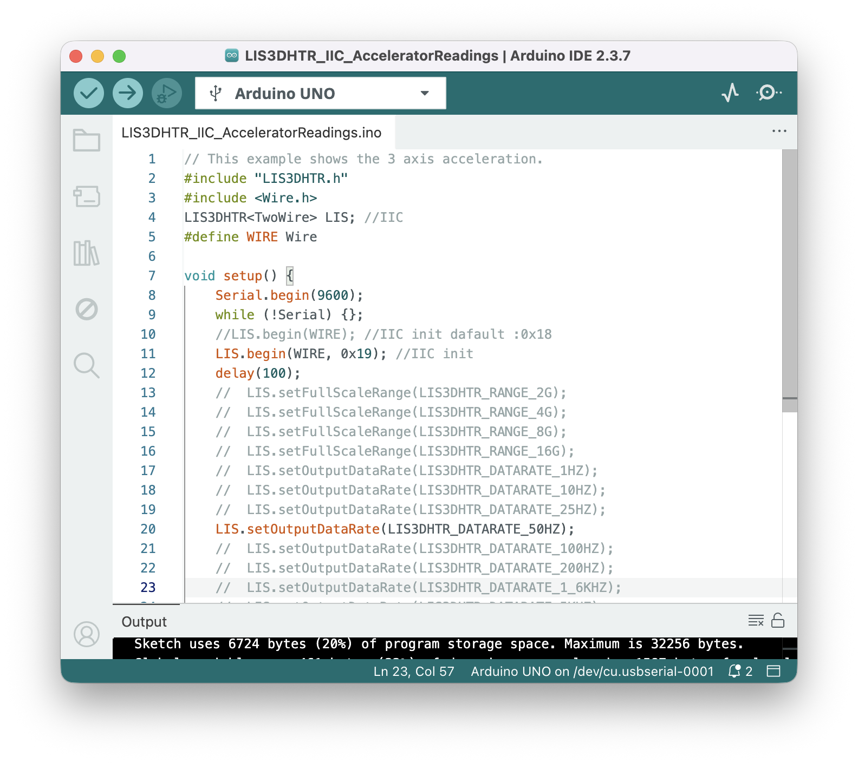
Check out the example
Change Serial.begin(115200) to 9600
Add // at the beginning of
LIS.begin(WIRE)
Delete the // at the beginning of
//LIS.begin(WIRE, 0x19)
Your code should look like this after the edits
Verify code and upload

Slide 47
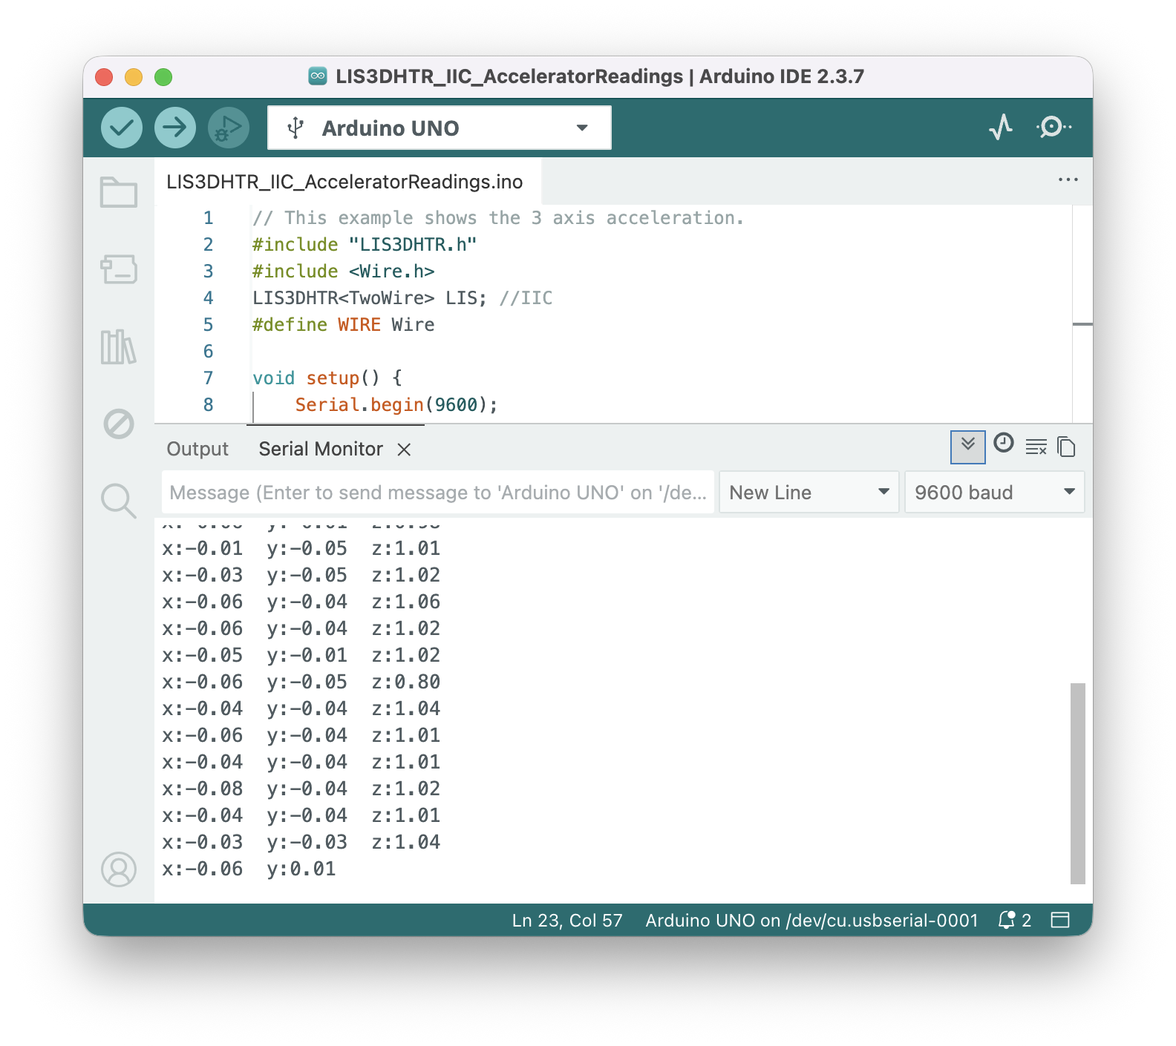
Open Serial Monitor
You should have data printed out
Use the data however you want!

